Slide 1
Sahel & North Africa

Slide 2
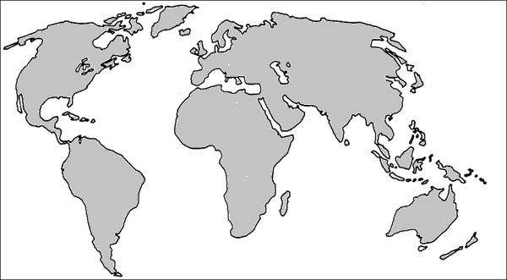
#1-6. Name the continents. #7. Which continent is not shown?
4
1
5
3
2
6

Slide 3
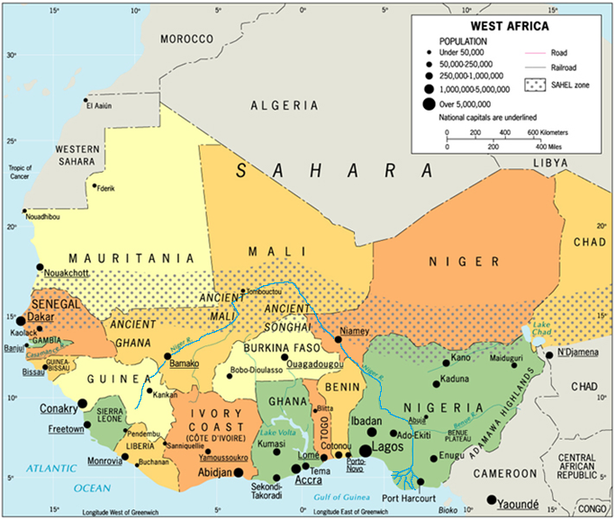
1. Name the largest city shown. #2-5. Through what 4 countries does the Niger River flow? 4. For which country is the Niger River the northern border?
http://www.people.eku.edu/davisb/africa/WestAfricaMap.jpg

Slide 4
#1-7: Name all 7 countries shown here that include part of the Sahel.
http://www.people.eku.edu/davisb/africa/WestAfricaMap.jpg

Slide 5
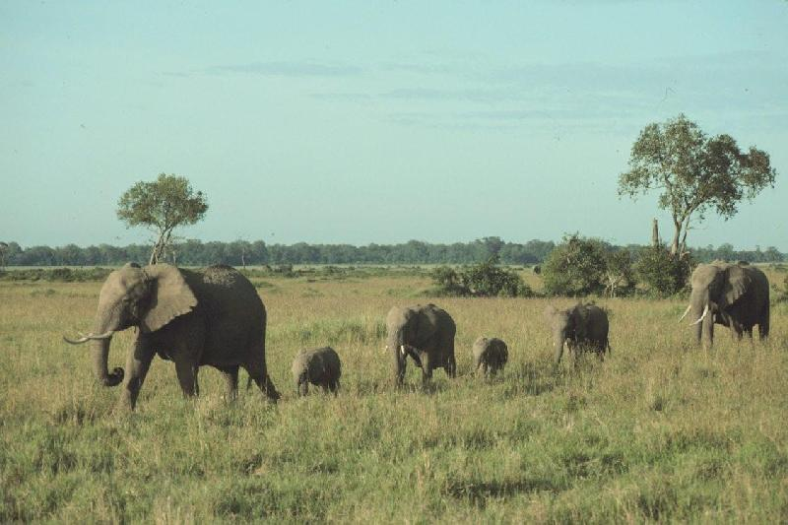
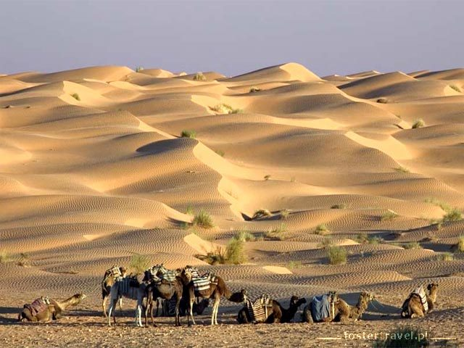
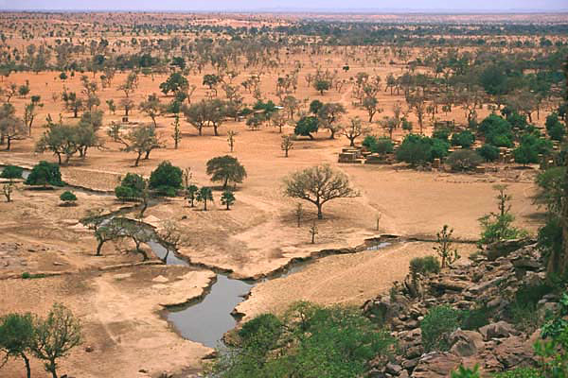
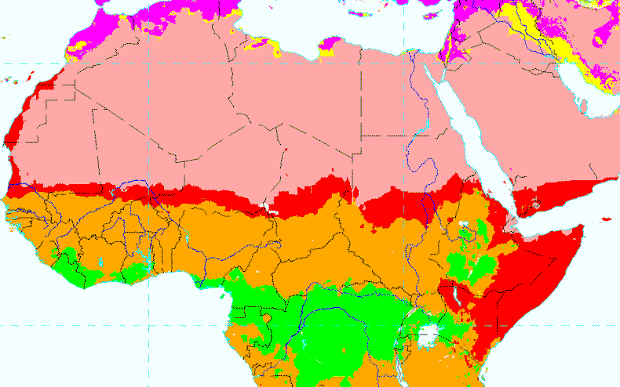
Sahara Desert Sahel Savanna
1.
2.
3.
Match the three photos with the three ecosystems (biomes) in the map key.
http://passel.unl.edu/UserFiles/Image/mmamo3/TimKettler/Biomes/Biomes-Africa_800x830.gif

Slide 6
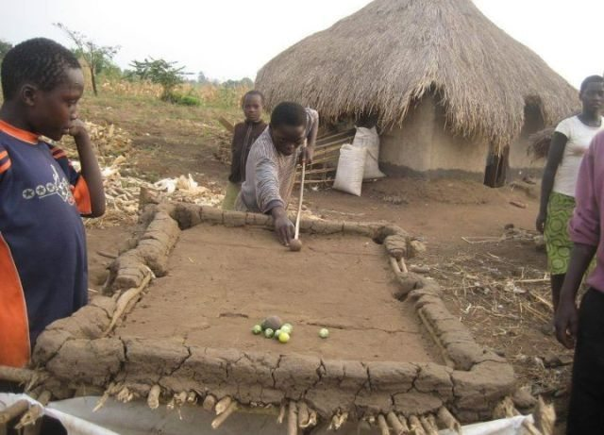
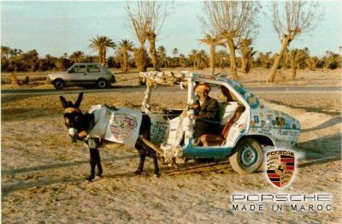
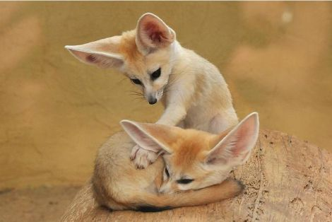
Sahara Desert Sahel Savanna
Match the three photos with the three ecosystems (biomes) in the map key. State your evidence!
1.
http://www.huffingtonpost.co.uk/2012/05/23/africa-pool-table-mud-sticks-photo_n_1538606.html
2.
3.
http://www.zooborns.com/zooborns/2010/08/los-angeles-zoos-got-your-fennec-fox-fix.html

Slide 7
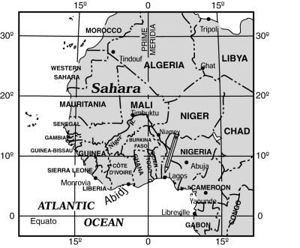
1-3. What three countries on this map are 30⁰North of the equator? 4. What country located at 20⁰N 0⁰? 5. In #4, why doesn’t 0⁰ have E or W after it?
http://www.worldmapsonline.com/images/lesson-plans/wm4d.jpg

Slide 8
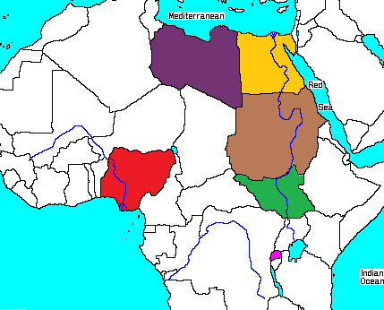
#1-6. Name the countries.
2
3
4
1
5
6
http://media.onsugar.com/files/2011/05/18/6/1632/16329924/d6/afr95blank.gif

Slide 9
RED or BLUE? 1. Which lines tell how far you are from the Prime Meridian? 2. Which ones tell how far you are from the Equator?

Slide 10
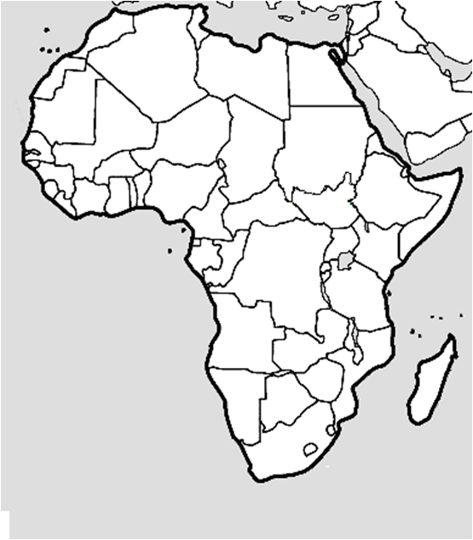
1-3. Name the cities – and the countries they are in. A-C. Name the bodies of water.
B
❶
❷
A
C
❸

Slide 11
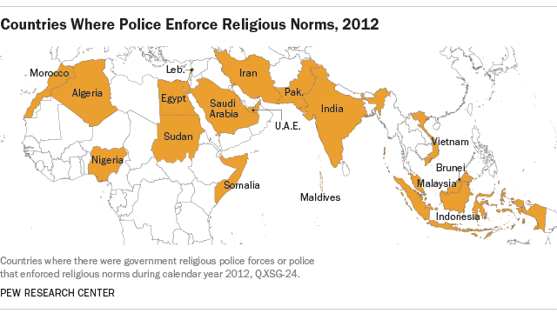
1. What does this map tell you about one reason South Sudan wanted to be independent from Sudan? 2. Why do you suppose so many countries have religious laws instead of having total freedom of religion?

Slide 12
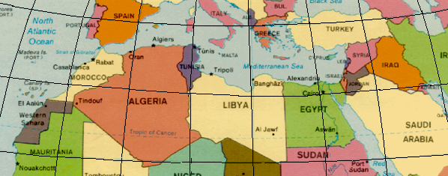
Name the countries at these absolute locations:
❶25⁰N 40⁰E
❸ 35⁰N 5⁰E
❷20⁰N 10⁰W
❹ 41⁰N 0⁰
20⁰W
10⁰W
0⁰
10⁰E
20⁰E
30⁰E
40⁰E
50⁰E
❹
40⁰N
❸
30⁰N
❶
❷
20⁰N

Slide 13
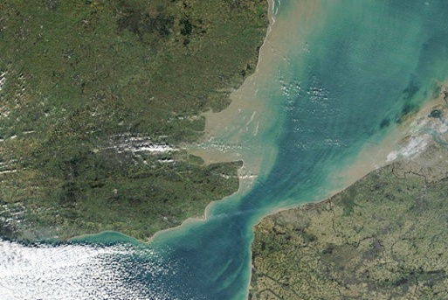
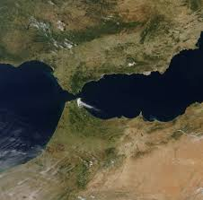
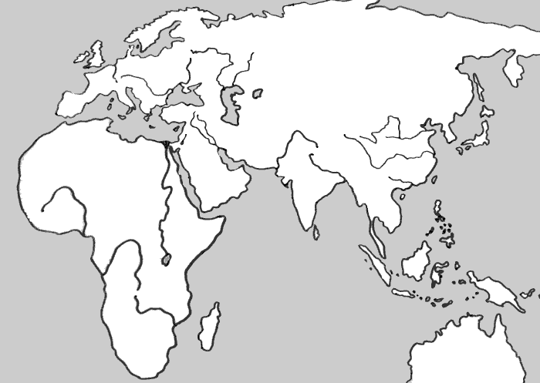
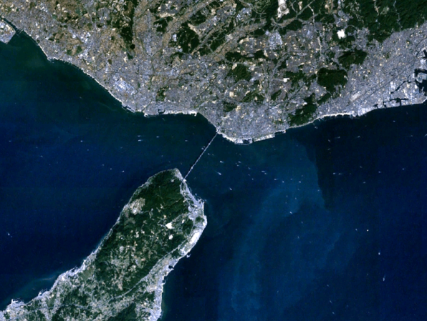
1. What are bodies of water like this called? (Check your map. It is PART of a place label.) 2. What is the name of the one marked  on the map below? (Check your Africa map!!) 3. Which satellite photo do you think goes with location from question #2?
http://indianapublicmedia.org/harmonia/years-england-france/
A
B
http://www.eosnap.com/image-of-the-day/strait-of-gibraltar-and-nearby-cities-spain-and-morocco-may-31st-2011/
C
★
http://commons.wikimedia.org/wiki/File:Akashi-Strait_1.png

