Slide 1
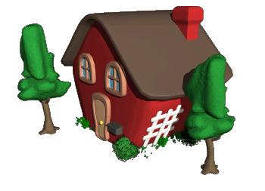
Human Geography
By the end of this power point presentation, you will be able to:
Define KEY TERMS: rural, urban, megalopolis, suburban, migration, immigration, emigration, and push - pull factors

Slide 2
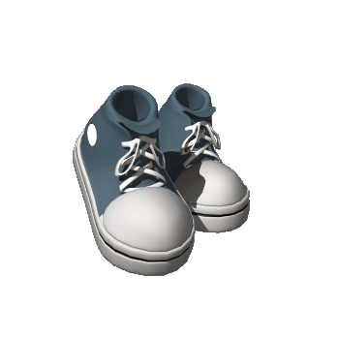
Key Term
What does rural
mean?

Slide 3
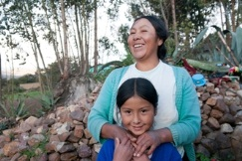
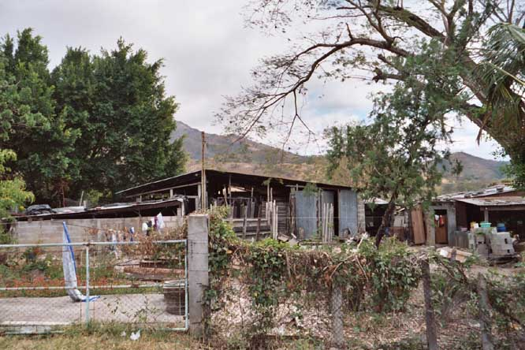
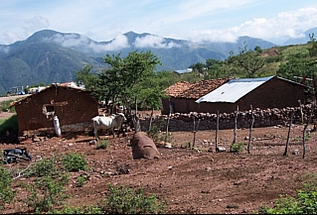
Rural means countryside.

Slide 4
Key Term
What does urban
mean?

Slide 5
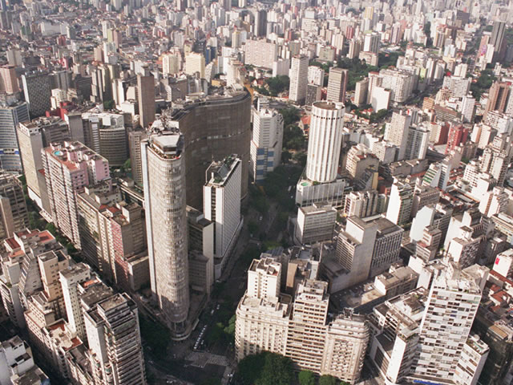
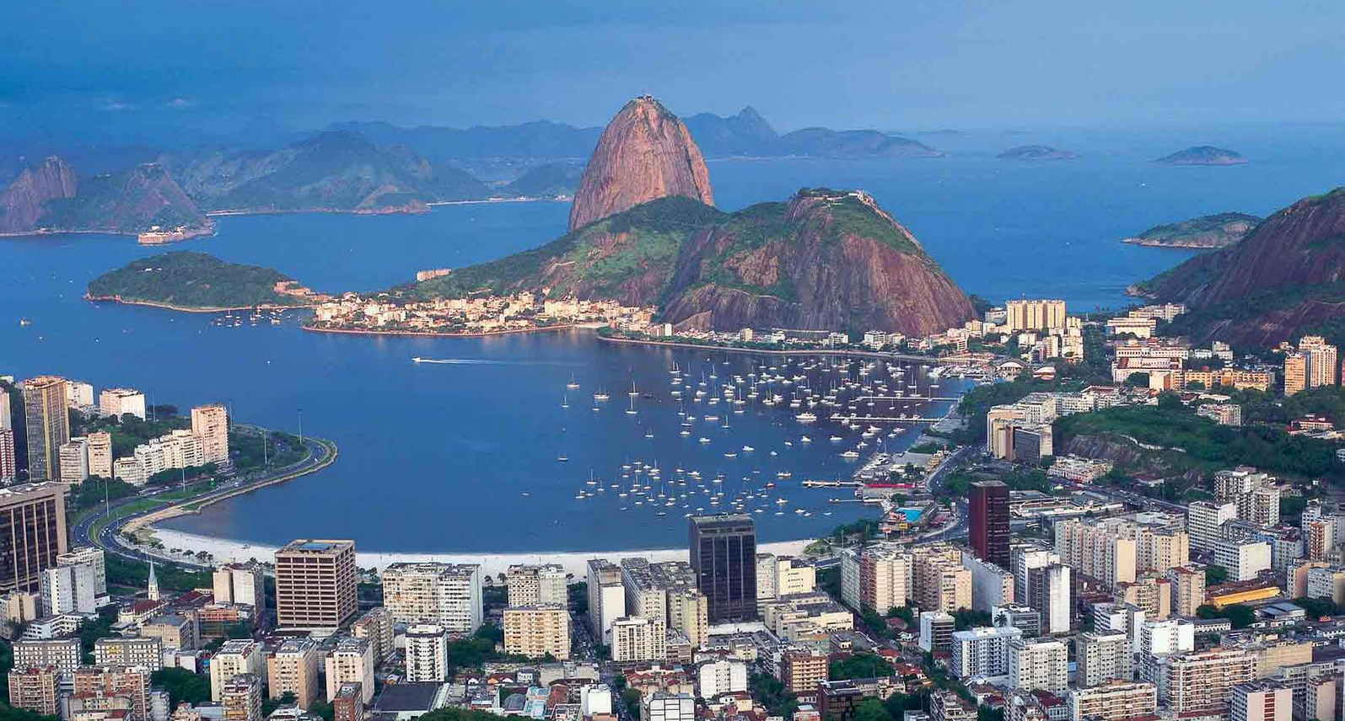
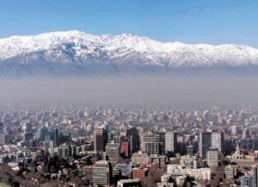
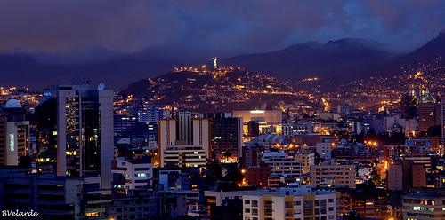
Urban means city life.

Slide 6
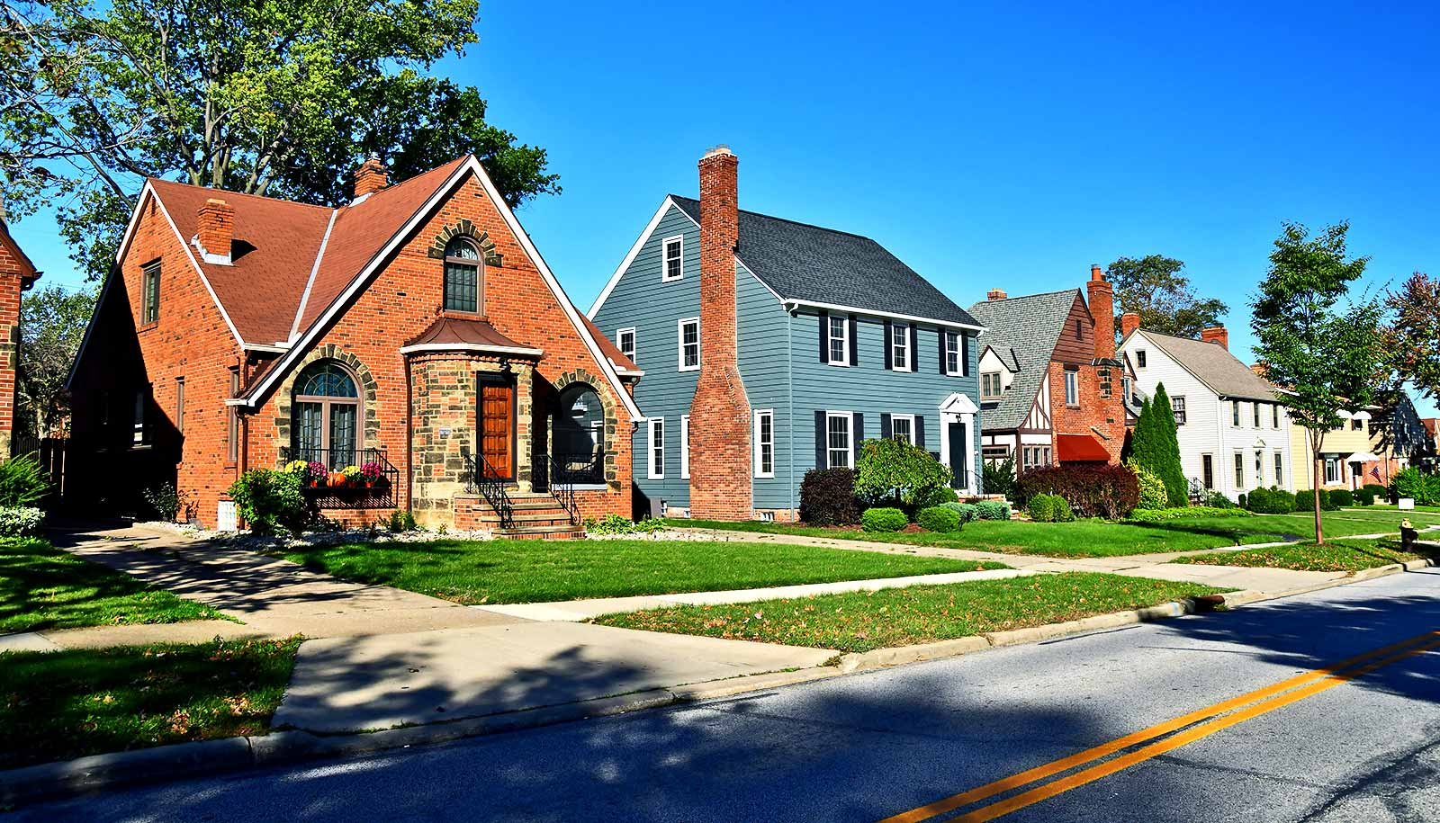
Key Term
What does suburb mean?

Slide 7
suburb means:
a location lying immediately outside a city or town, especially a smaller residential community

Slide 8
Key Term
What does megalopolis mean?

Slide 9
megalopolis means:
a huge city with an extremely large population

Slide 10
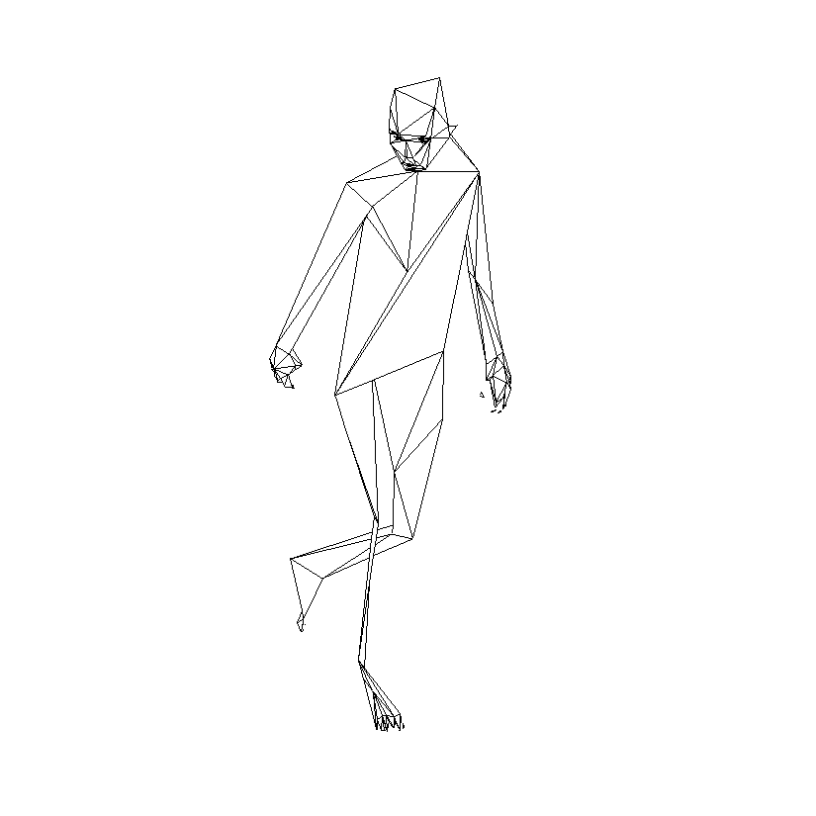
Key Term
What does
migration
mean?

Slide 11
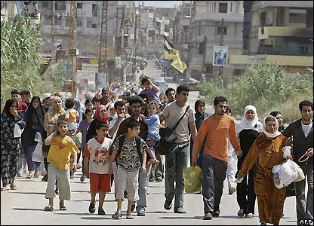
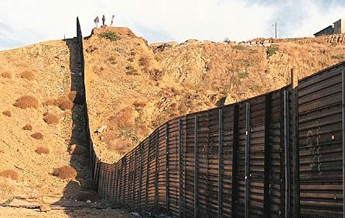
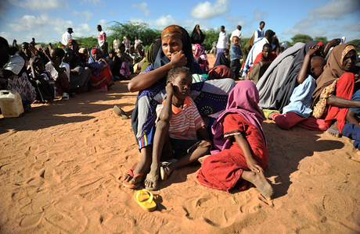
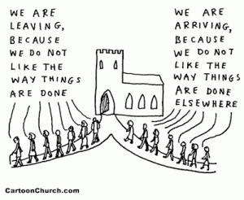
Migration means the movement of people from one area or region to another

Slide 12
Migration
The movement of people from one country to another

Slide 13
Emigration
the action to leave one’s home country to live in another permanently.

Slide 14
Question
Do you remember the important word
we used in class for emigration that is not
stated in this definition?
Check your notes in your
Interactive Notebook

Slide 15
EXIT

Slide 16
Immigration
the action of coming to live permanently in a foreign country

Slide 17
Question
Do you remember the important word
we used in class for immigration that is not
stated in this definition?
Check your notes in your
Interactive Notebook

Slide 18
IN

Slide 19
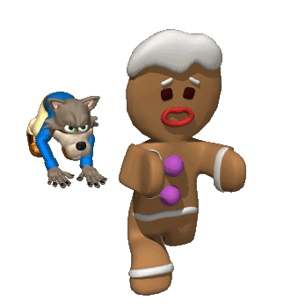
People migrate from one place to another for two reasons
1. Push Factors
People want to get away from things they do not like in their country
For some people, it is poor housing or inadequate health care for their children or no schools at all

Slide 20
2. Pull Factors
People are attracted to things they do like in another country
For some people, it is to find better paying jobs to improve their living conditions. It also includes finding better schools for their children and better health care.

Slide 21
Finished already???
Try the bonus question

Slide 22
The following statements were all made by people that have moved.
State whether they were influenced by push factors, pull factors or both push & pull factors.

Slide 23
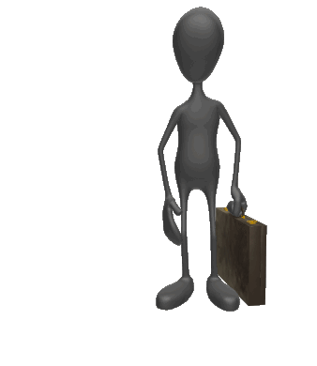
A friend offered
me a job and a place to live in the country.
Push Factor
Pull Factor
Push & Pull Factors
1

Slide 24
PULL!

Slide 25
I was forced
off my land.
I had to leave!
Push Factor
Pull Factor
Push & Pull Factors
2

Slide 26
PUSH!

Slide 27
I moved into the
city for the night-life.
Push Factor
Pull Factor
Push & Pull Factors
3

Slide 28
PULL!

Slide 29
My sons are ill. There are no doctors in our village but there are hospitals in another country.
Push Factor
Pull Factor
Push & Pull Factors
4

Slide 30
PUSH & PULL!

Slide 31
Our village was
washed away by floods
Push Factor
Pull Factor
Push & Pull Factors
5

Slide 32
PUSH!

Slide 33
My children had no
chance to go to school in the country. There are schools in another
country.
Push Factor
Pull Factor
Push & Pull Factors
6

Slide 34
PUSH & PULL!
Well done!
The END

Slide 35
SUCCESS
Keep on studying or reviewing this power point presentation
If success in class is important to you, make the time to succeed
If success in class is important to you, overcome excuses of why you didn’t have time to study
Television and Social Media will always be around, a chance to improve your status begins now

Slide 36
Now test yourself?
What is meant by rural?
What is meant by urban?
What is meant by megalopolis?
What is meant by migration, immigration, and emigration?
What is a push factor?
What is a pull factor?
Give 3 examples of push factors.
Give 3 examples of pull factors.

Slide 37
WELL DONE!

